Slide 1
Strengthening climate policies through the Convention’s reporting tools
Global Support Programme
for National Communications, Biennial Update Reports and Intended Nationally Determined Contributions
for Non Annex I countries
Tuesday December 8th, Rio Pavilion
COP 21, Paris

Slide 2
National Communications – Non Annex I Parties
Status of reporting
A very reduced amount of countries have not submitted yet the first NC
Around forty countries are working on their SNC
Almost a hundred countries are preparing the TNC
One country has submitted a Fourth and Fifth NC
Several Barriers such as:
Lack of harmonized national institutional framework
Lack of technical capacities to prepare solid quality reports
Limited access to data
Limited consultation and weak stakeholder consultations processes

Slide 3
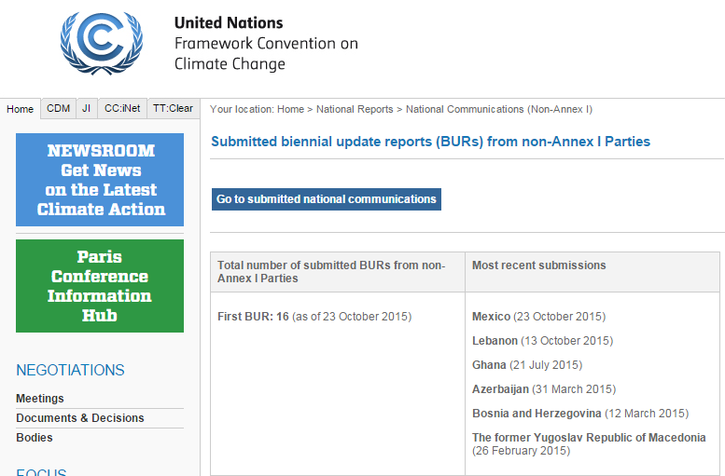
BURs – Non Annex I
Consulted on December 6th, UNFCCC website

Slide 4
INDCs
State of Play: 4 December 2015
157 submissions,
reflecting 184 countries (including the European Union member states)
and covering around 94% of global emissions in 2010 (excluding LULUCF)
and 97% of global population.
Source: Climate Action Tracker

Slide 5
Support to Countries by UNDP/UNEP
Two tier support, in partnership with GEF
UNDP and UNEP as implementing agencies provide mayor support to countries in access to funding and oversight during project implementation
Together we work with more than:
135 Countries on their National Communications
80 Countries on their Biennial Update Reports
GSP to support countries to overcome institutional and technical barriers, fostering south-south collaboration between countries

Slide 6
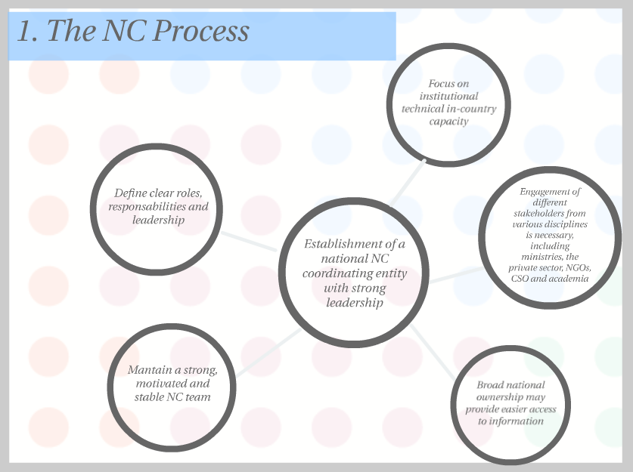
Lessons learnt

Slide 7
Lessons learnt

Slide 8
Lessons learnt
Important to ensure technical rigor
Data
Technical experience on GHG Inventory, mitigation models and V&A scenarios
QA/QC
Moving from communications to actions
Support to development of national plans, including design of development planning processes
Communicate the communications!
Mobilize financial resources

Slide 9
The Global Support Program is here to help you
Targetted support as GSP’s phillosophy, but prioritization based on where technical assistance is most needed
Act as a facilitator: GSP not meant to cover all technical support alone. Coordination with others is crucial - Enhance efficiency
Maximize online assistance: To respond quickly and expand support to greatest number of countries
One-to-one but posting for others to benefit (FAQ), as appropriate
Webinars, discussion forums, others
Knowledge exchange to dissemination good practices
Technical peer review at the request of countries

Slide 10
GSP key components
Institutional arrangements for the preparation of NCs and BURs
Technical and policy-relevant guidance materials, dissemination of methodologies and tools, and thematic/sub-regional training, among others
Knowledge management, best practice, communication and outreach

Slide 11
Some examples of how the GSP can provide support
Adaptation/Mitigation
Institutional arrangements *
QA/QC procedures *
Scenarios and modelling
MRV
Gender mainstreaming *
Communicating results in an effective way
GHG inventory
National GHG inventory system
Data collection and analysis – data management
Use of 2006 guidelines and/or IPCC 2006 software
Training on specific sectors (AFOLU/Energy)
Development of emissions factors
Uncertainties of data and emissions calculations

Slide 12
Thank you!
Damiano Borgogno
Coordinator
damiano.borgogno@undp.org

